Slide 1
SECURE DATA HIDING IN IMAGE USING STEGANOGRAPHY
CAPSTONE PROJECT
Presented By:
Student Name : Vikas Chaure
College Name : Dr. DY Patil Arts, Commerce & Science College
Department : Computer Science Department

Slide 2
OUTLINE
Problem Statement
Technology used
Wow factor
End users
Result
Conclusion
Git-hub Link
Future scope

Slide 3
Problem Statement
In today’s digital world, sensitive information such as medical records, financial data, military secrets, and personal communications is increasingly stored digitally.
However, these digital files often lack robust security mechanisms, making them vulnerable to unauthorized access or interception during transmission.
Traditional methods of hiding data within images are becoming old due to advancements in steganographic techniques that can be easily detected by modern tools like AI and machine learning algorithms.
There is a growing need for secure and undetectable methods of embedding sensitive information within digital media, ensuring confidentiality and integrity during transmission.

Slide 4
Technology used
Programming Language: Python which is widely used for its simplicity and extensive libraries.
Library: OpenCV (cv2 module) in Python is commonly used for image manipulation and steganographic embedding/extraction.
System Specifications: The project should be tested on modern hardware such as:
Operating System: Windows 10, macOS, or Linux.
Processor: Intel Core i5 or AMD Ryzen 5 for smooth performance.
RAM: Minimum 4 GB (preferably more) due to the memory-intensive nature of OpenCV operations.
Storage: At least 10 GB free disk space on the drive where the project is being run.

Slide 5
Wow factors
The proposed method combines multi-layer encryption with steganography, providing an additional security layer compared to traditional steganographic techniques.
The use of OpenCV for both embedding and extracting hidden data ensures compatibility with modern image processing standards.
The project demonstrates robust error detection mechanisms to ensure accurate retrieval of hidden information even after multiple iterations.

Slide 6
End users
Financial Institutions: To protect confidential transactions, account details, and financial data during online banking or e-commerce platforms.
Military and Government Organizations: For secure communication channels to hide operational plans, intelligence, and strategic information from unauthorized parties.
E-commerce Platforms: To securely transmit sensitive customer data (e.g., credit card numbers) while encrypting images for online shopping experiences.
Journalists & Activists – Concealing sensitive information in images to avoid surveillance.

Slide 7
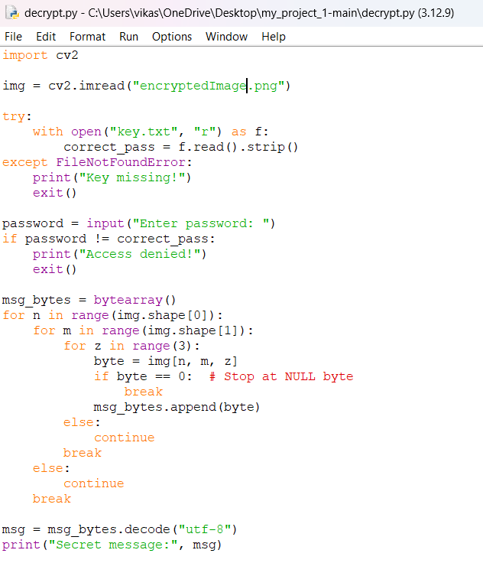
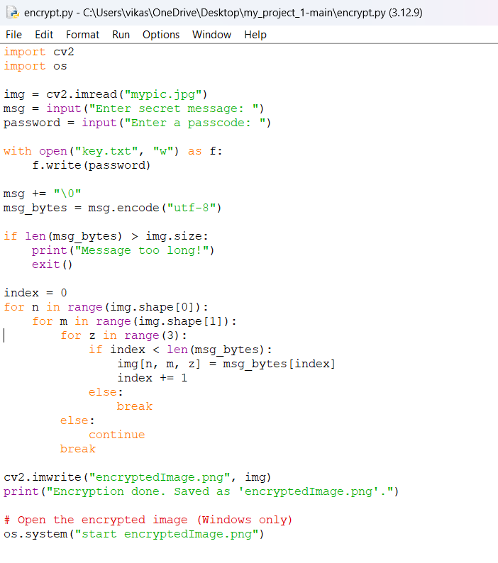
Results
← Encryption
Decryption →

Slide 8
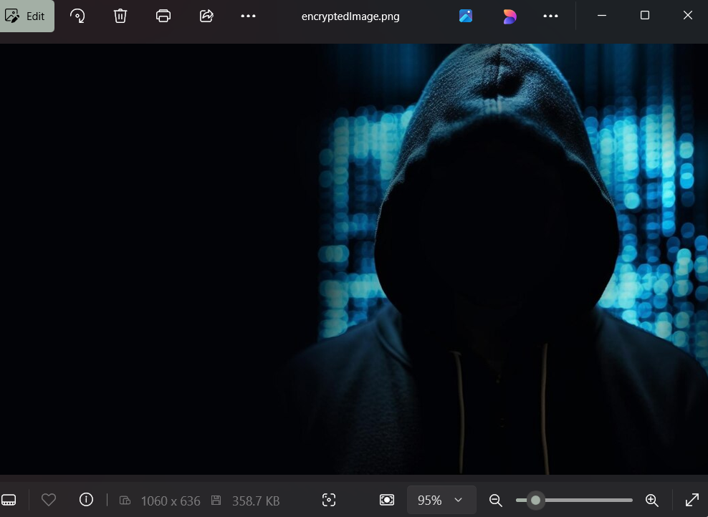
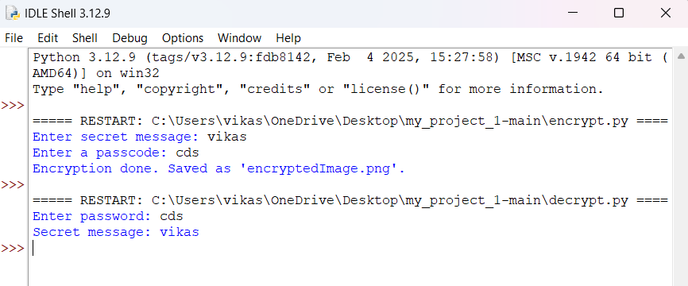
Results
← Encrypted Image
Output →

Slide 9
Conclusion
There are drawbacks even if our technology shows significant improvements in protecting private data from standard detection techniques. Despite our present security measures, attackers with access to strong steganographic analysis tools or machine learning algorithms may be able to discover secret data.
Moving forward, multi-layer encryption using hashing techniques and using machine learning for improved detection methods show potential for enhancing the security of our solution. These developments will guarantee stronger data security and support in defending against potential risks.
In overall, even though our idea efficiently addresses the demand for secure data transmission, continuous innovation is necessary to keep up with new developments in technology and ensure that sensitive data is protected for the long run.

Slide 10
GitHub Link
https://github.com/systempower105/project1.git

Slide 11
Future scope(optional)
Integration with Machine Learning: Incorporating machine learning algorithms to enhance the detection of hidden data within digital media, ensuring higher security levels.
User Authentication: Implementing advanced authentication mechanisms (e.g., biometric authentication) to secure access to the embedded/extracted data further.
Multi-Layer Protection: Expanding the encryption techniques to include hashing algorithms alongside steganography for added security against cyber threats.

Slide 12
THANK YOU

